Slide 1
Plasmid derived dsDNA contamination in mRNA vaccines
ICS V
Feb 23, 2024
Kevin McKernan,
CSO Medicinal Genomics

Slide 2
Conflicts
We do not participate in any C19 related business
We manufacture qPCR kits for the agricultural genomics space
We authored 2 PrePrints on dsDNA contamination in mRNA vaccines

Slide 3
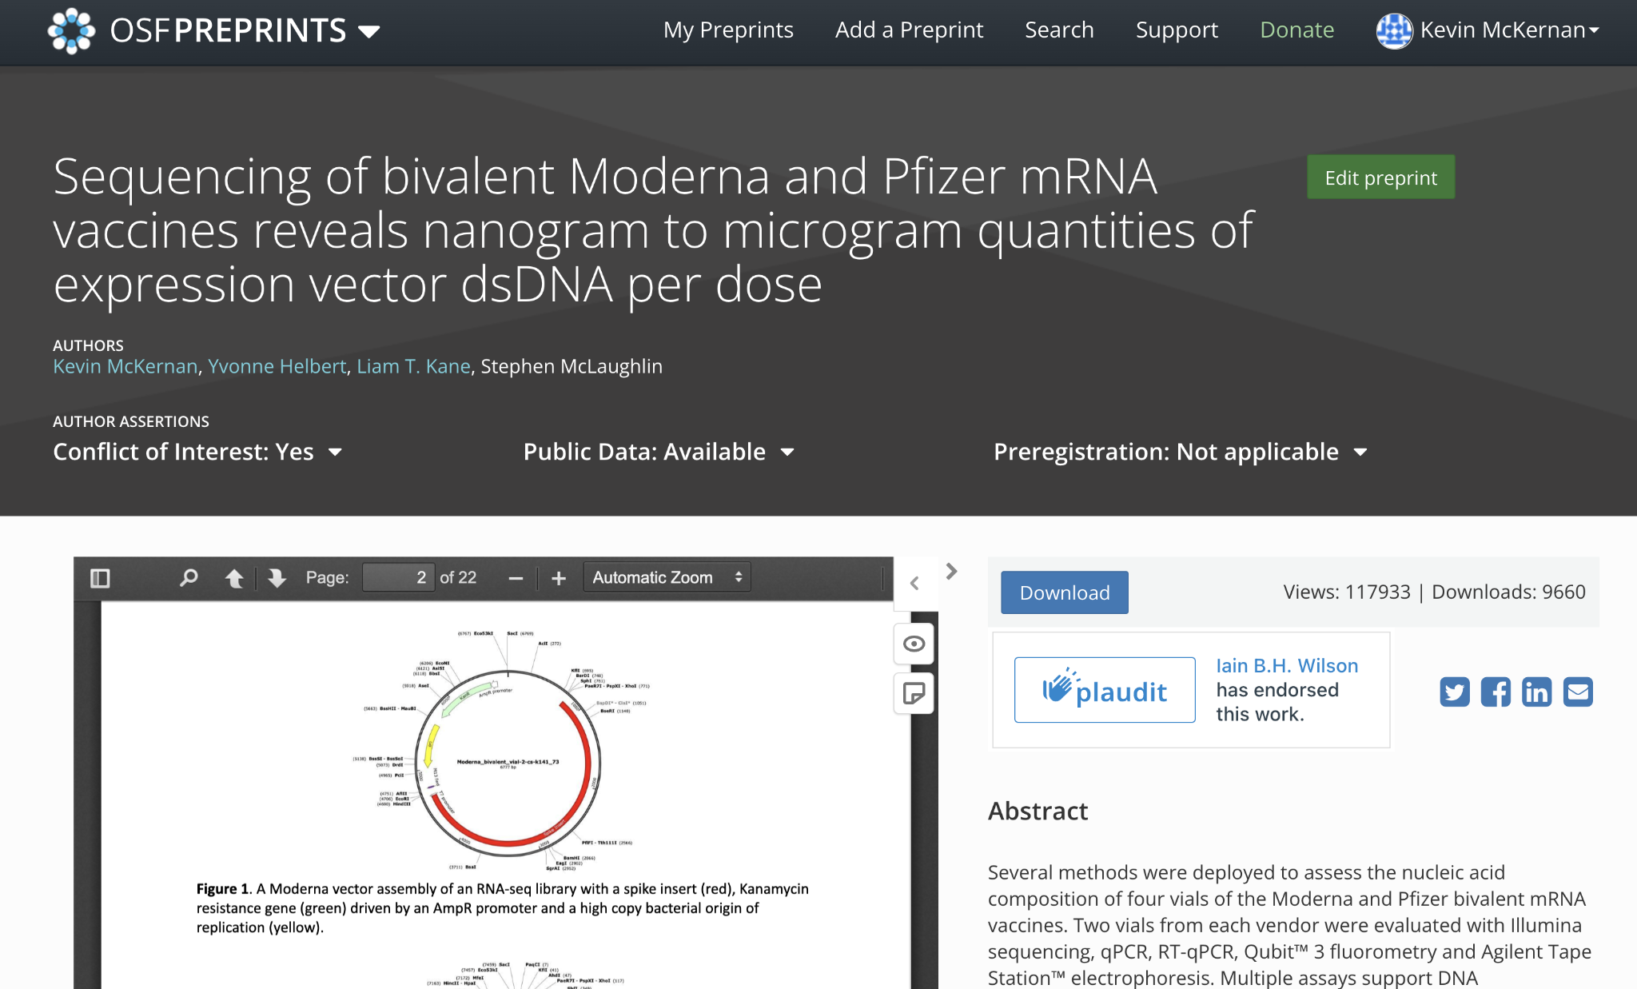
Illumina sequencing and RT-qPCR and qPCR
All sequence data is public and qPCR assays and sequence publicly available.

Slide 5
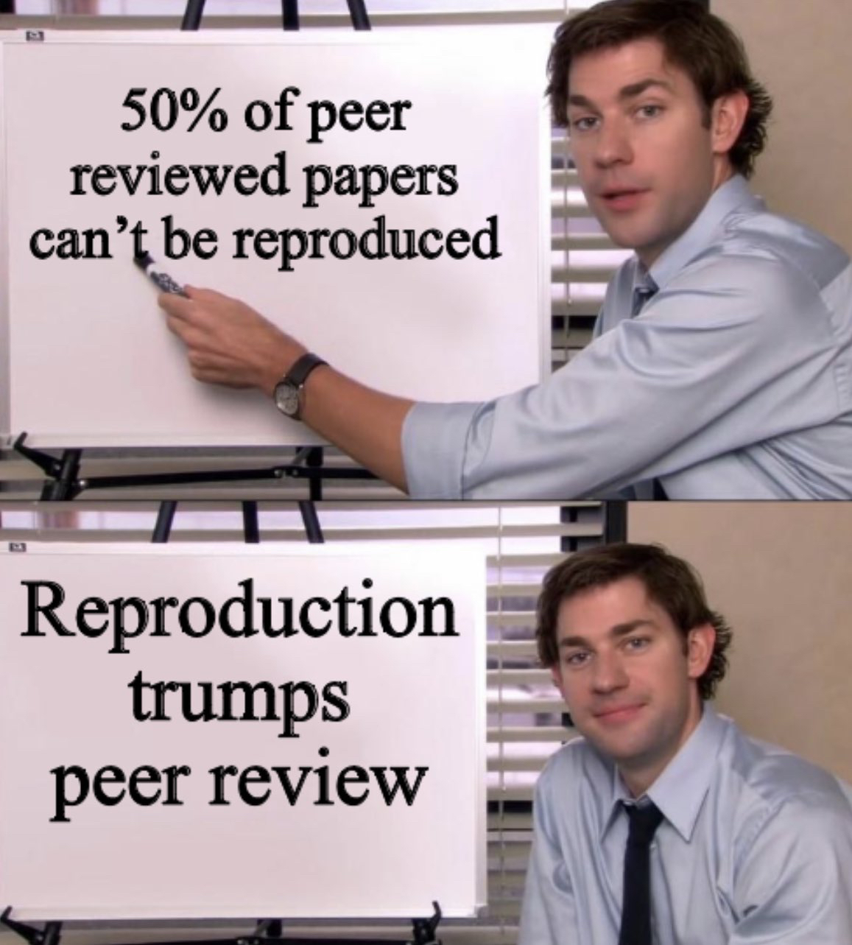
Fact Checker Chorus: “It’s not peer reviewed!”

Slide 6
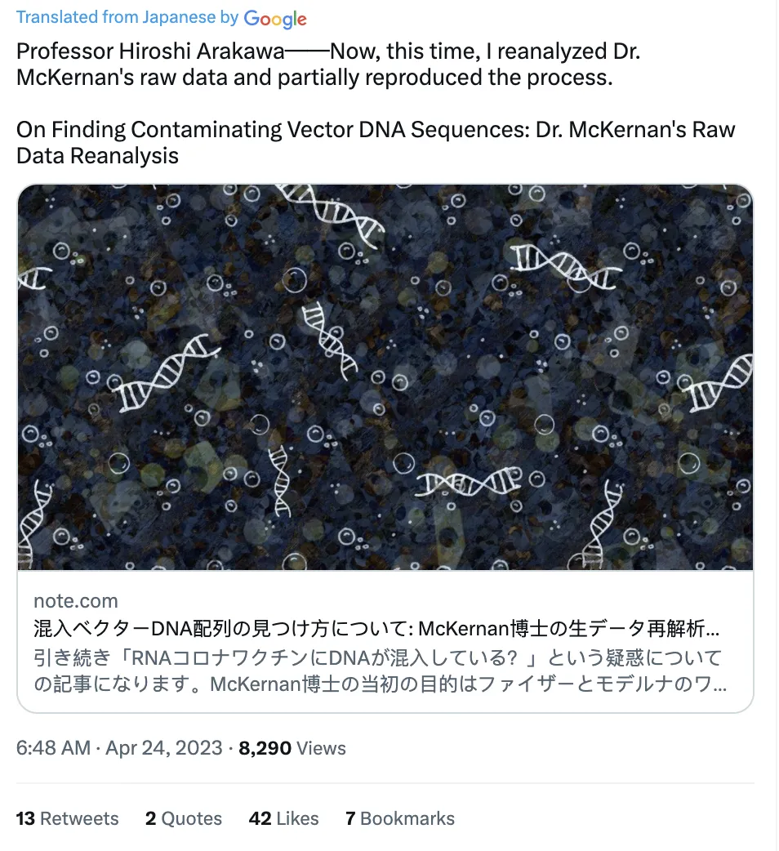
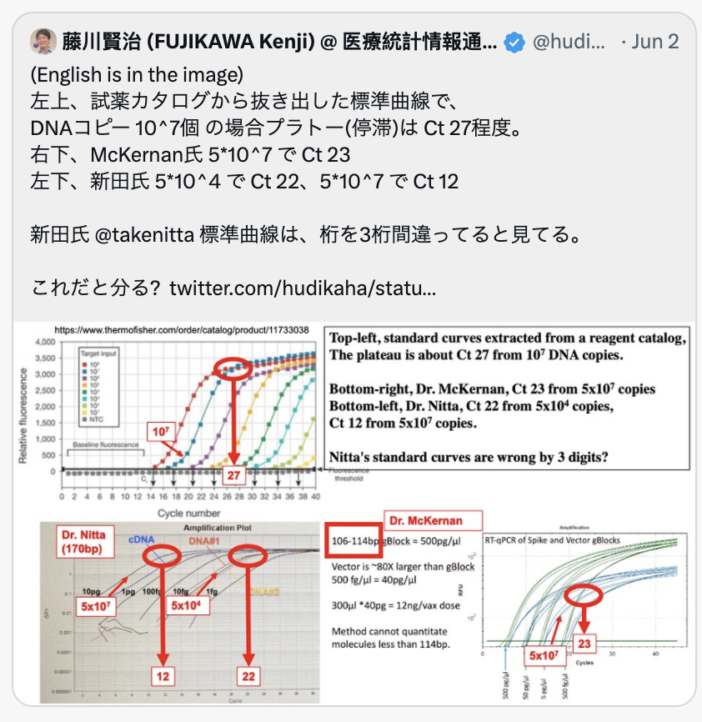
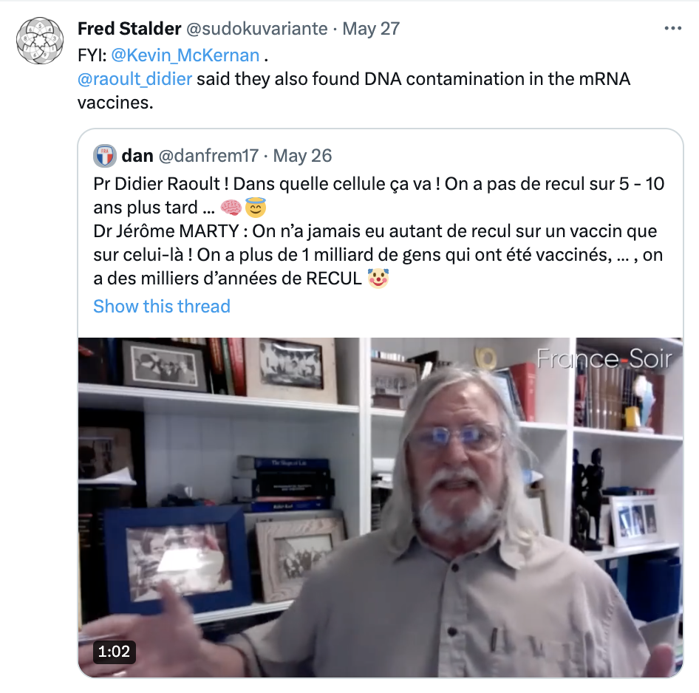
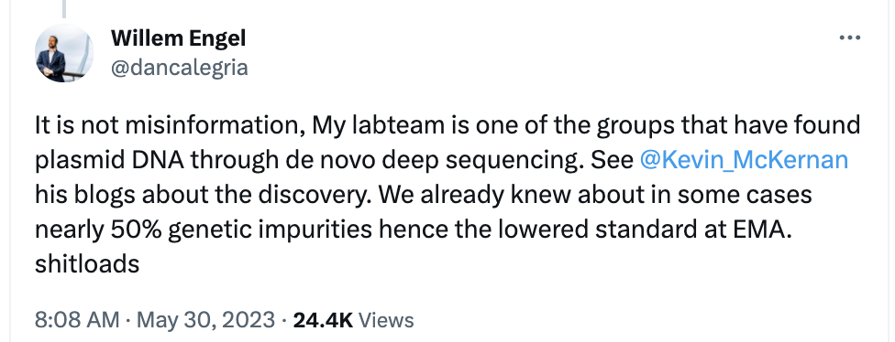
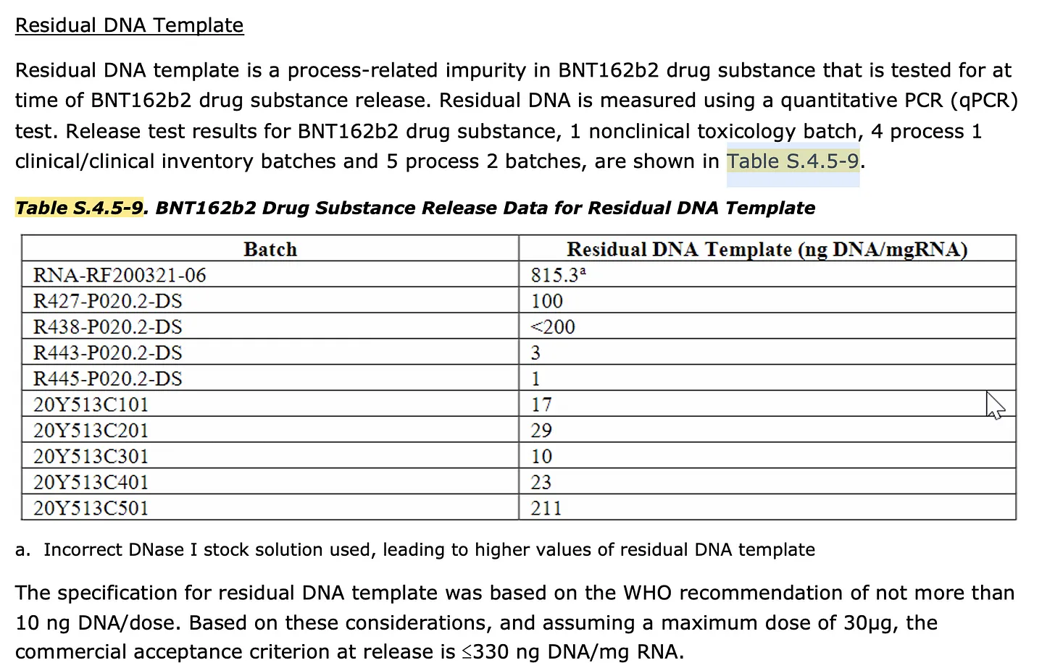
Reproduction
815X variance across 10 lots EMA

Slide 7
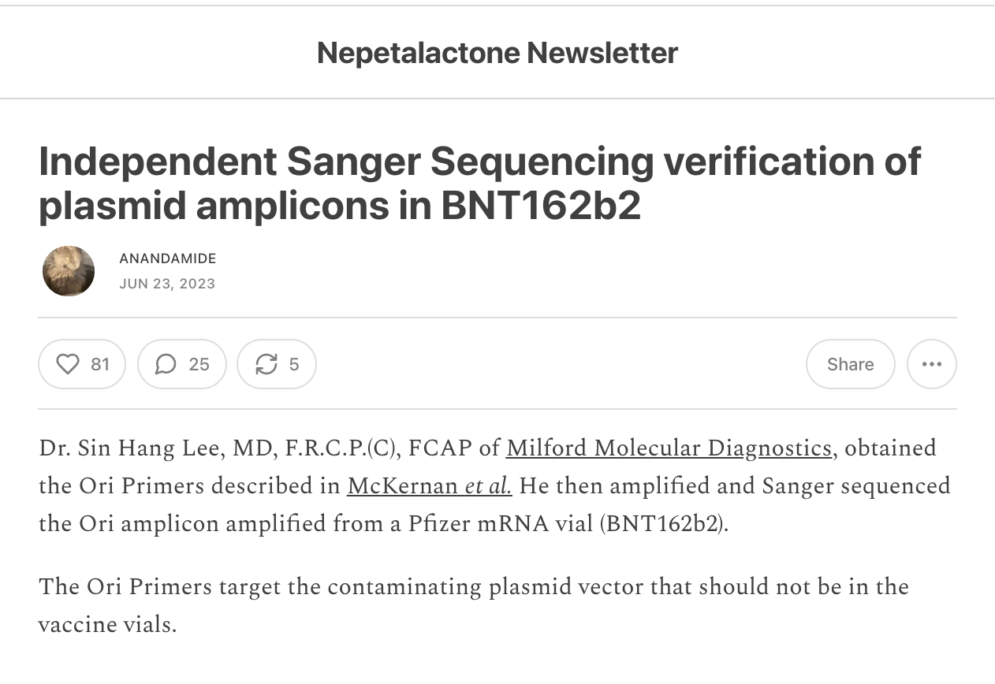
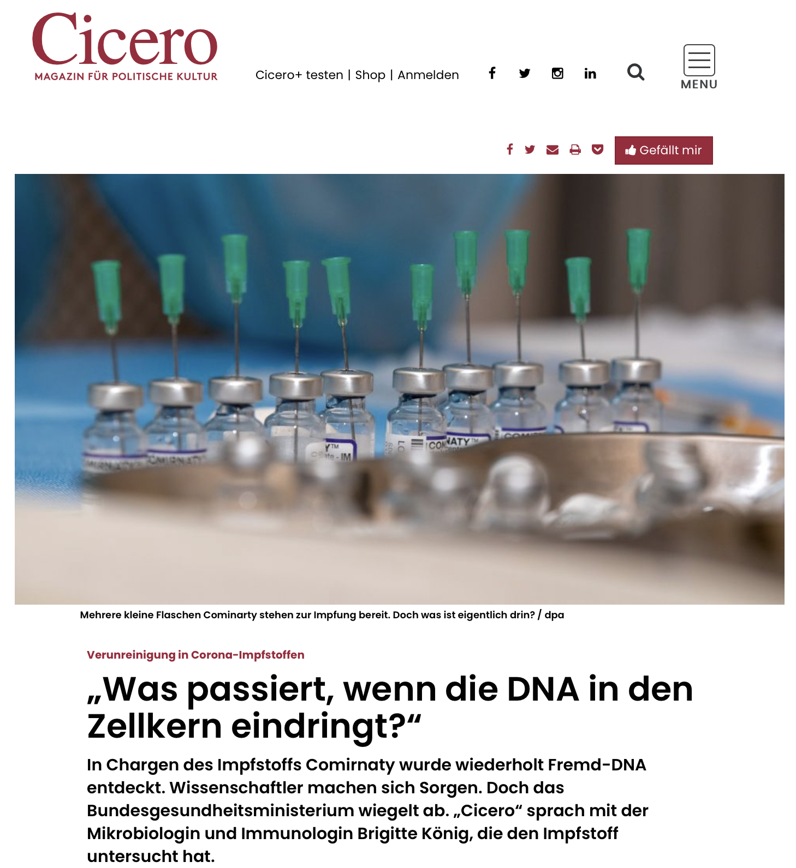
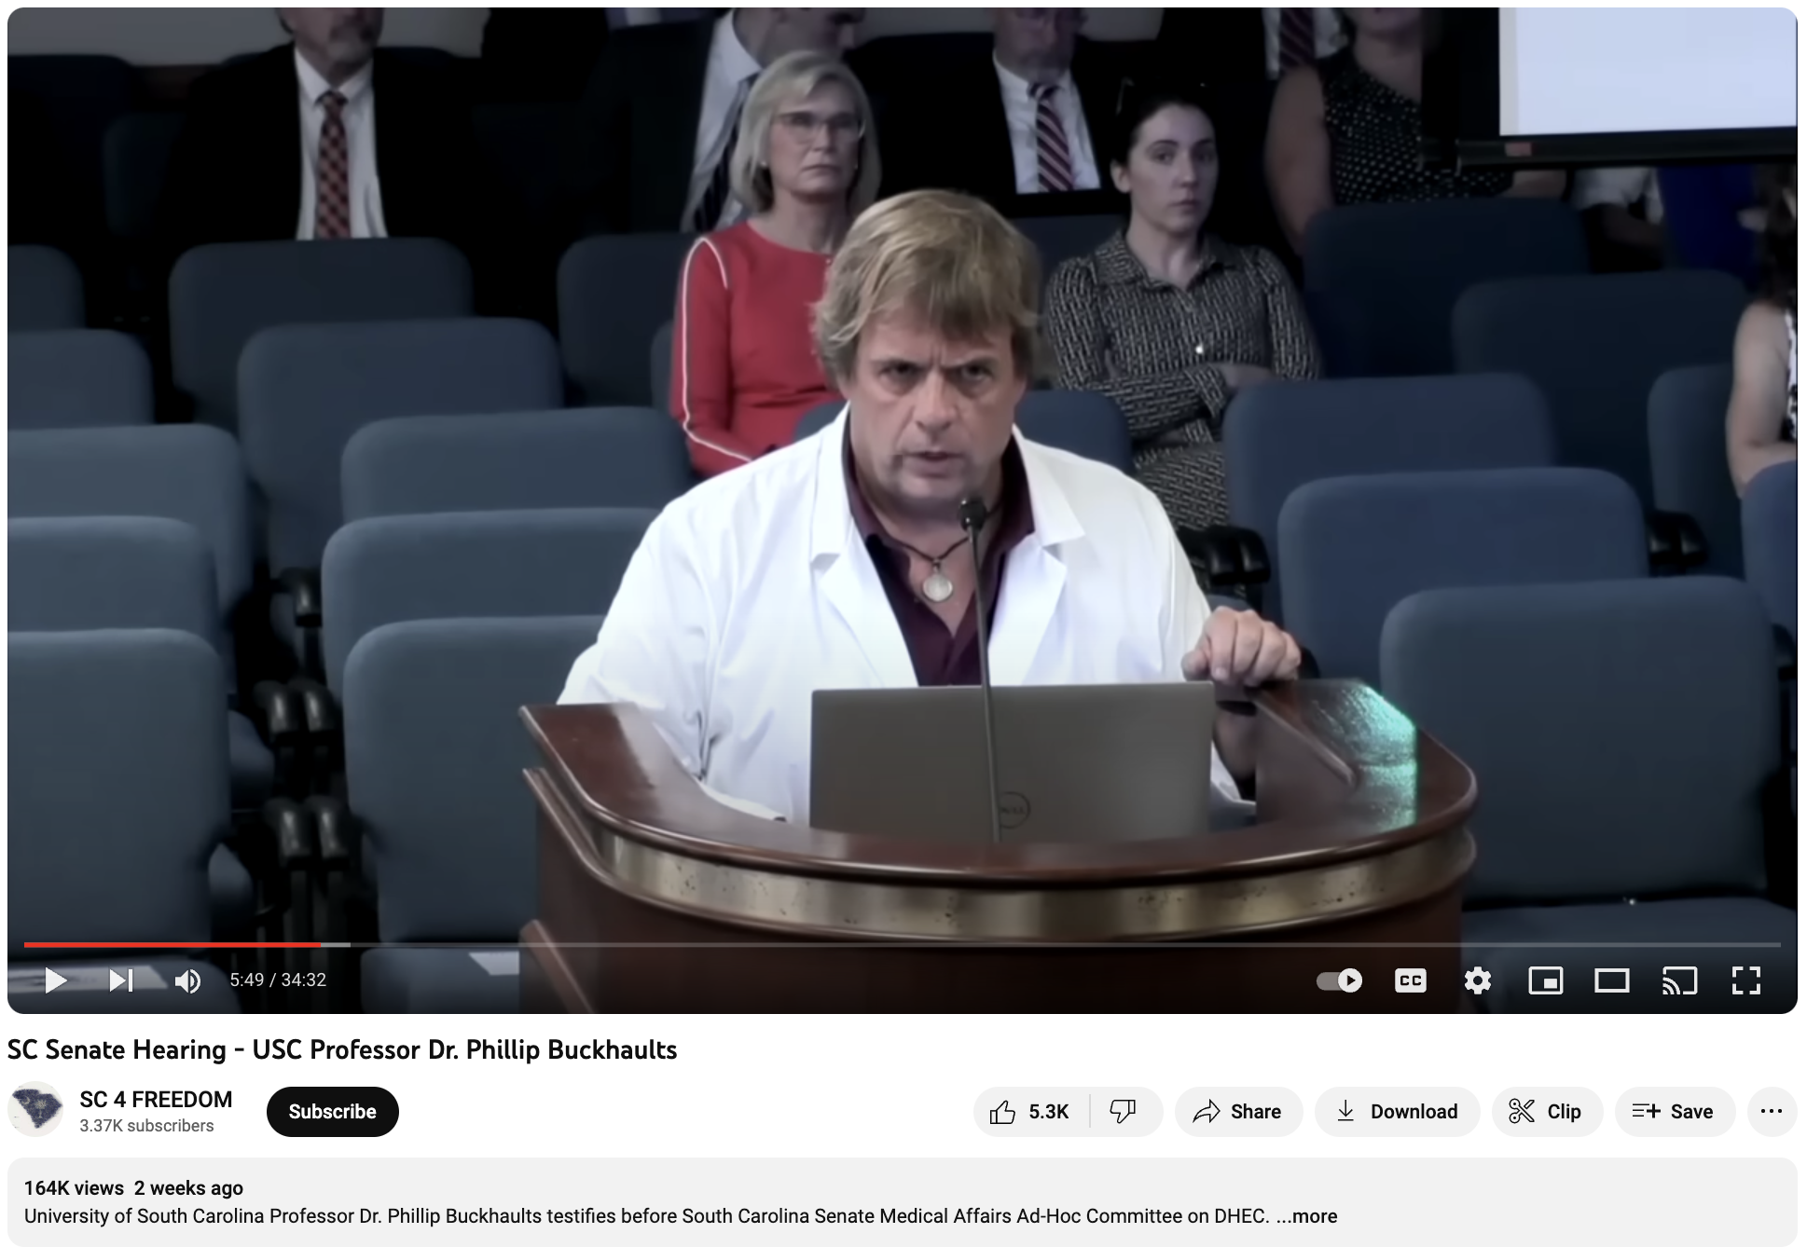
International replication
Dr. Phillip Buckhaults
Dr. Sin Lee
Dr. Brigitte Konig

Slide 8
Regulatory Response 1)Yes, SV40 is there 2)Yes, Pfizer did NOT spell this out 3)DNA is too small in length to matter 4)DNA is too small in quantity to matter 5)DNA is non-functional
Regulators are correct
Regulators are wrong

Slide 9
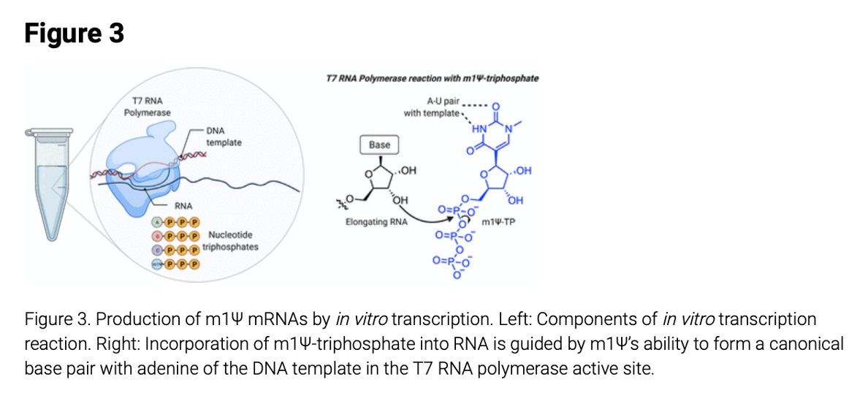
Process 1 used In Vitro Transcription (IVT)
Process 2 used Plasmids in E.coli
Synthetic DNA template
cloned DNA template
IVT reaction
IVT reaction
Nance et al
Nance et al

Slide 10
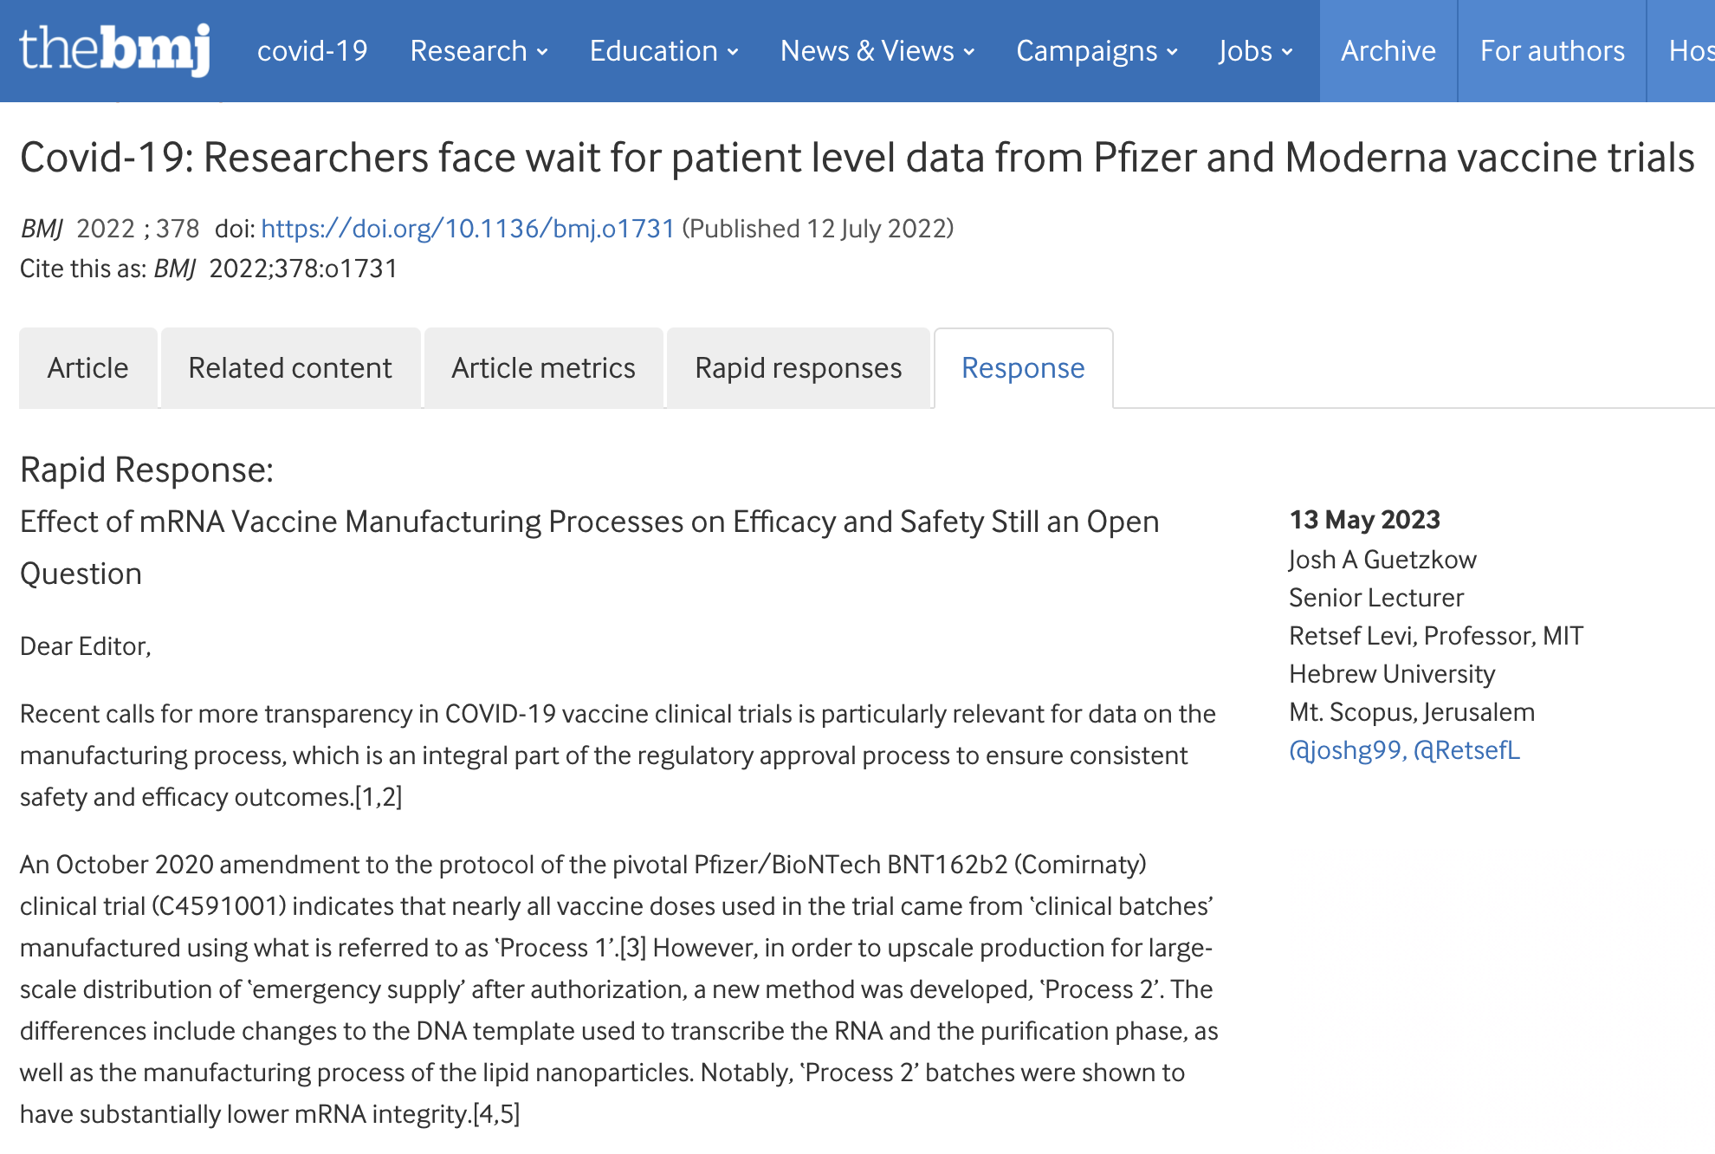
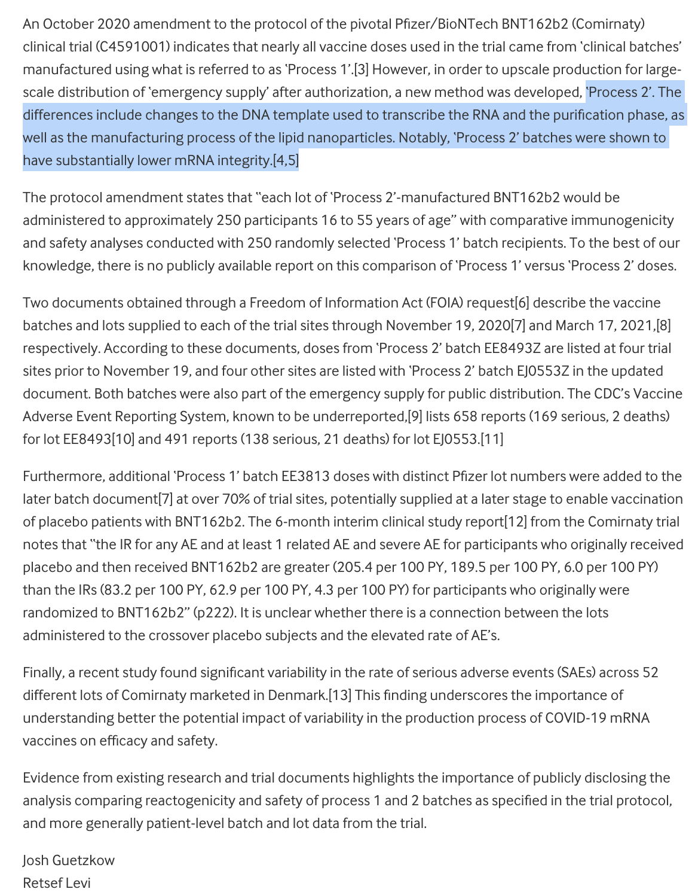
Process 1 (IVT) vs Process 2 (E.coli)
The trial was run on Process 1 lots
250 people received Process 2 lots (plasmids)
The world received Process 2 lots

Slide 11
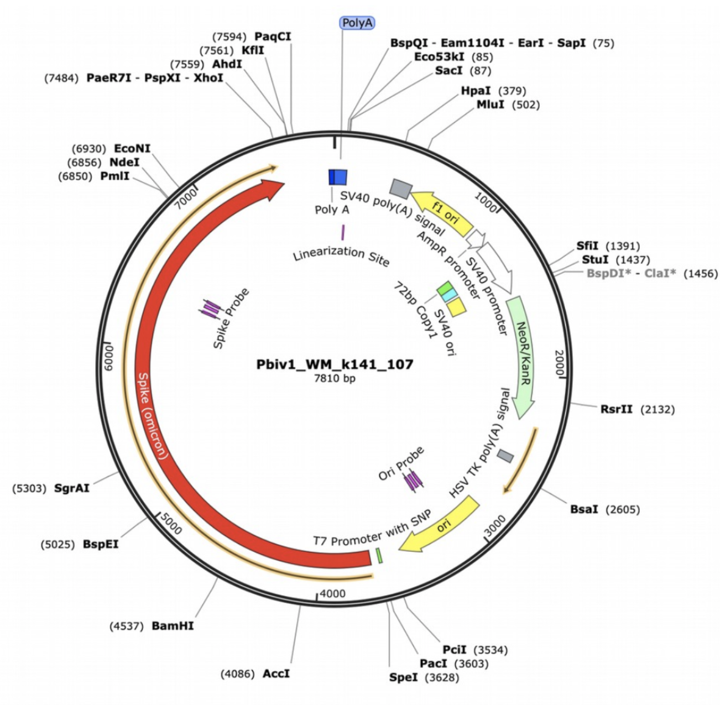
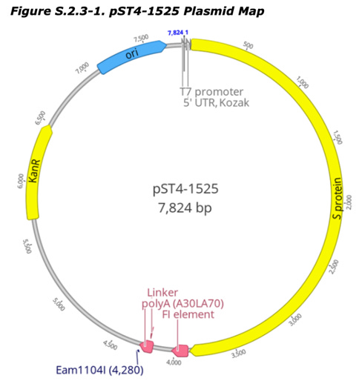
Independent Illumina sequencing
What was disclosed to the EMA
No sequencing provided
SV40 omitted?
Raw reads public

Slide 12
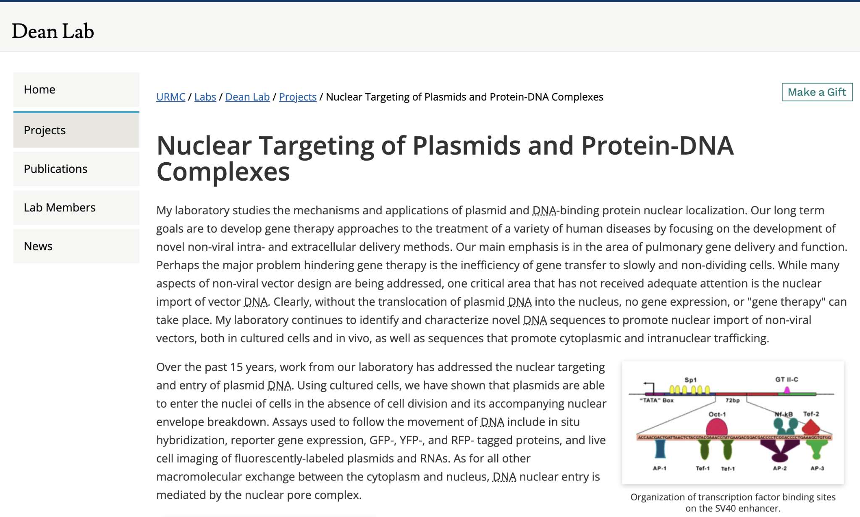
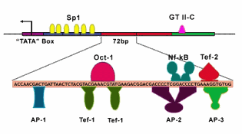
SV40 Enhancers are used in Gene Therapy:
Nuclear Targeting Sequences (NTS) Fact Checkers will not address this slide!

Slide 13
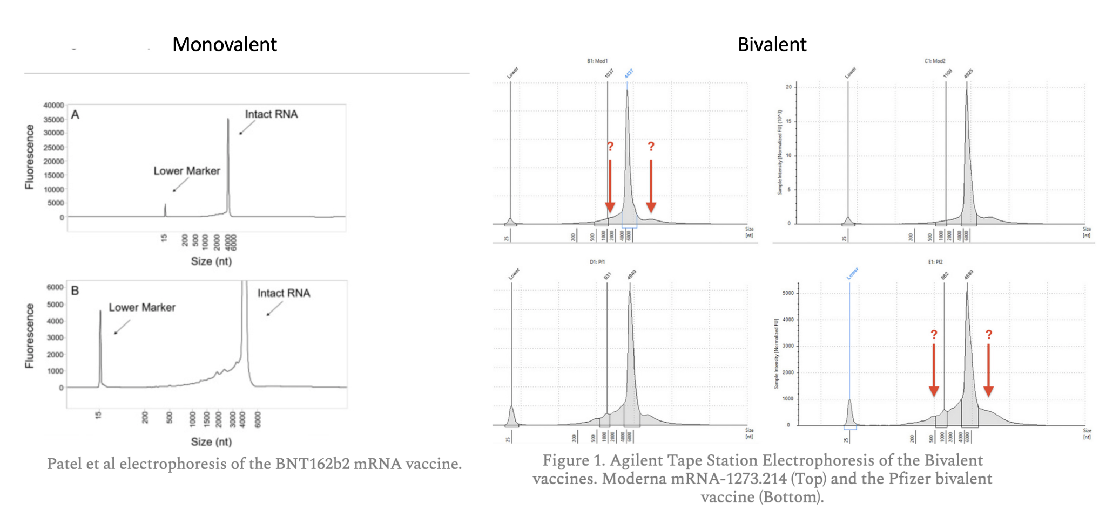
Limitations- Expired lots Fact Checkers will not address this slide!
The RNA integrity on arrival can be confirmed
Expired lots were injected into patients

Slide 14
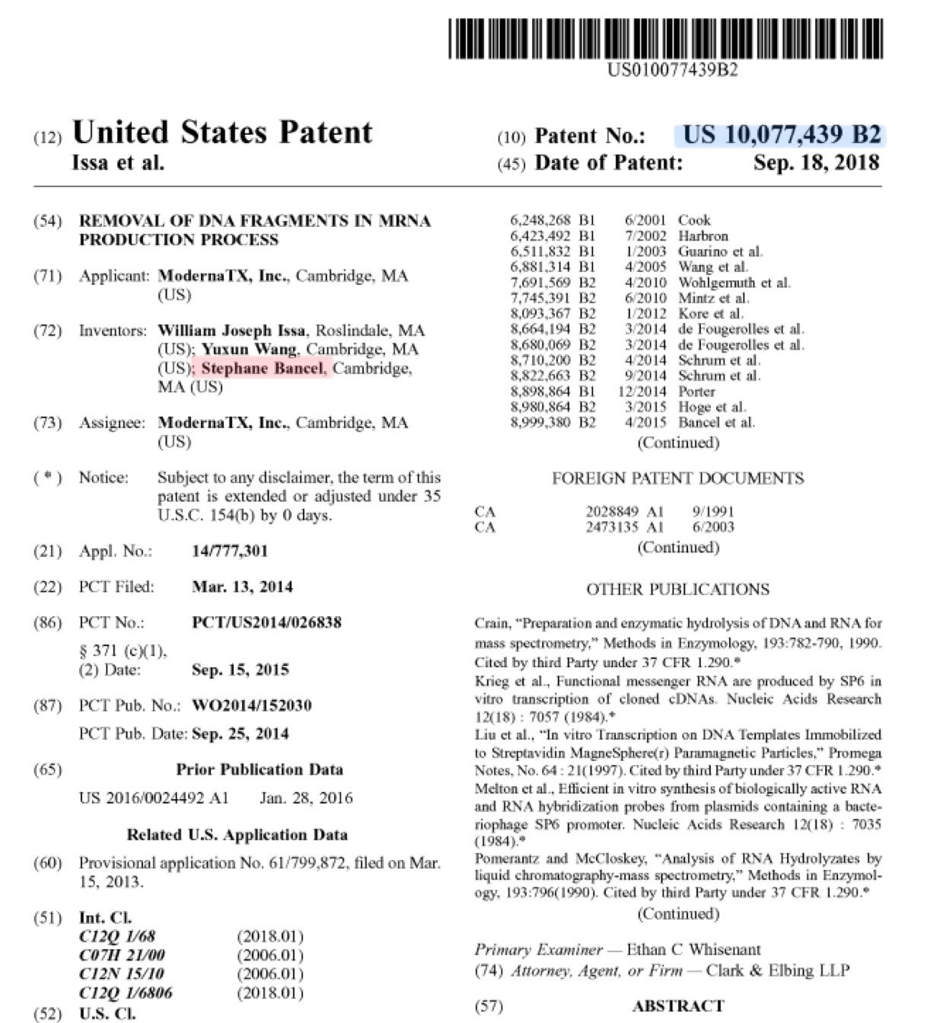
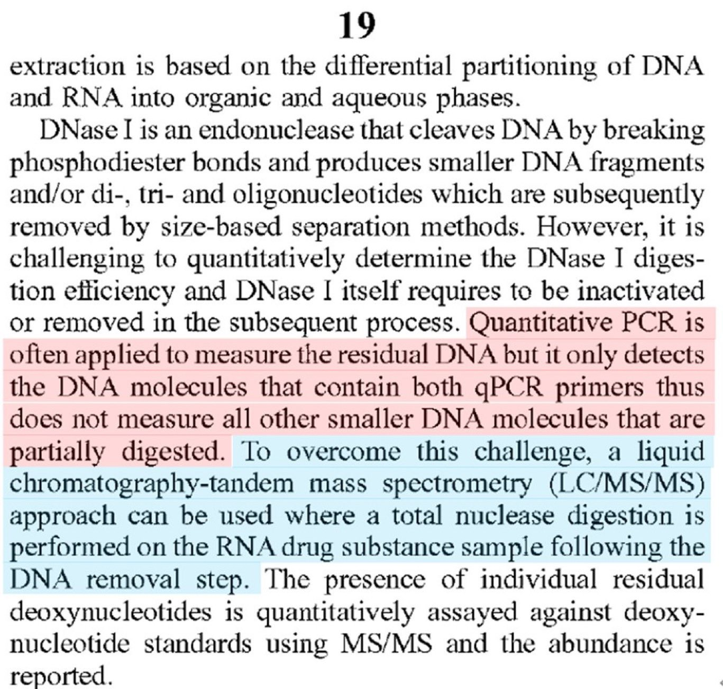
Moderna Patents speak to the failure of qPCR to measure all DNA: CEO Stephane Bancel is an inventor.

Slide 15
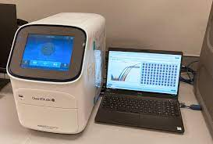
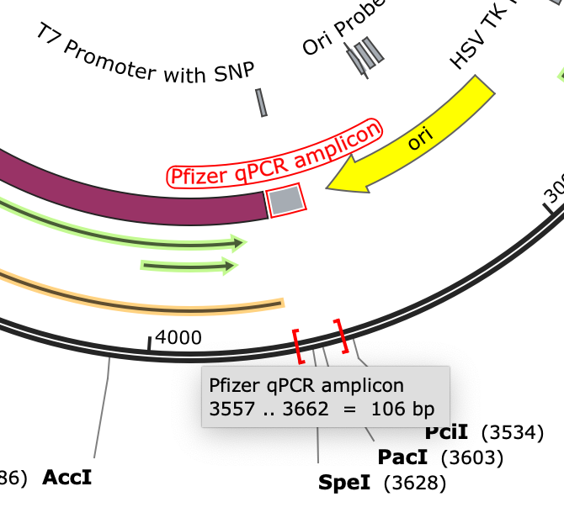
How to Game the Regulators Use two different yard sticks
EMA regulations are a Ratio of RNA:DNA of 3030:1
Inflate RNA with RiboGreen
Deflate DNA with qPCR
RT-qPCR measures RNA?
qPCR measures DNA?
Pfizers primers target RNA and DNA?
Why did Pfizer not use qPCR for measuring RNA and DNA?
Because they can’t pass the spec and regulators are too inept to understand they are getting played

Slide 16
Fluorometry with RNase A

Slide 17
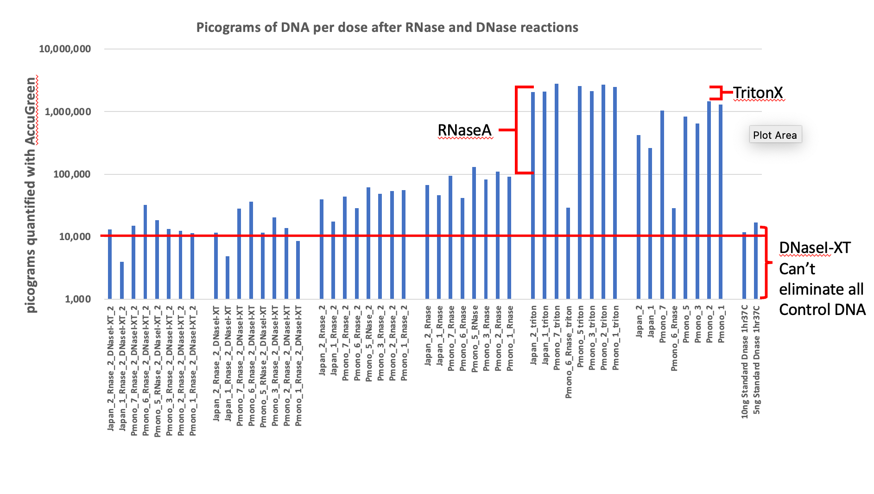
Over the Limit

Slide 18
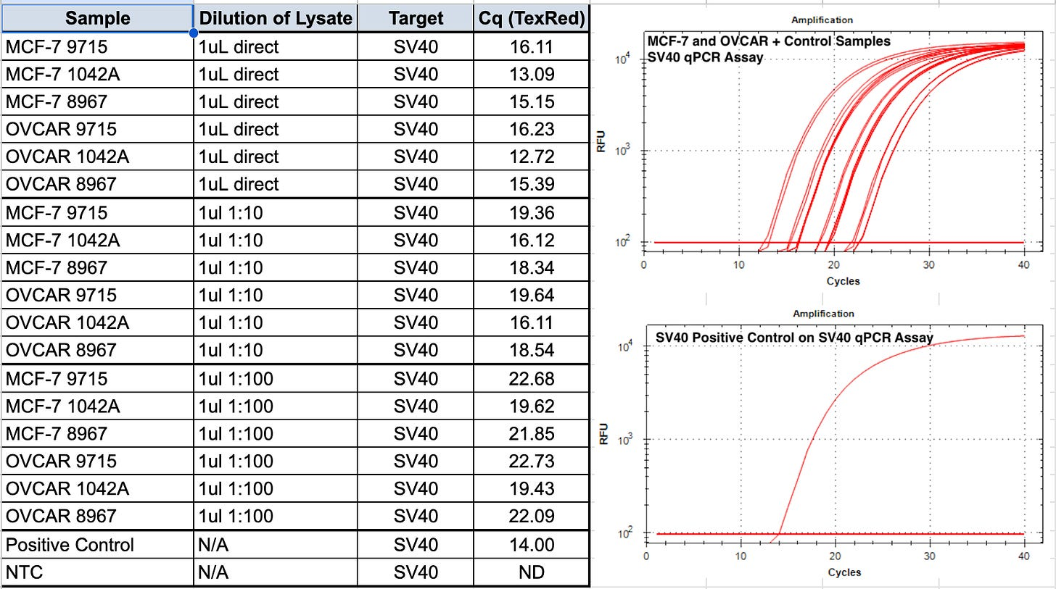
~20 fold higher than previous vaccines Lot 1F1042A BioNtech
Ulrike Kaemmerer

Slide 19
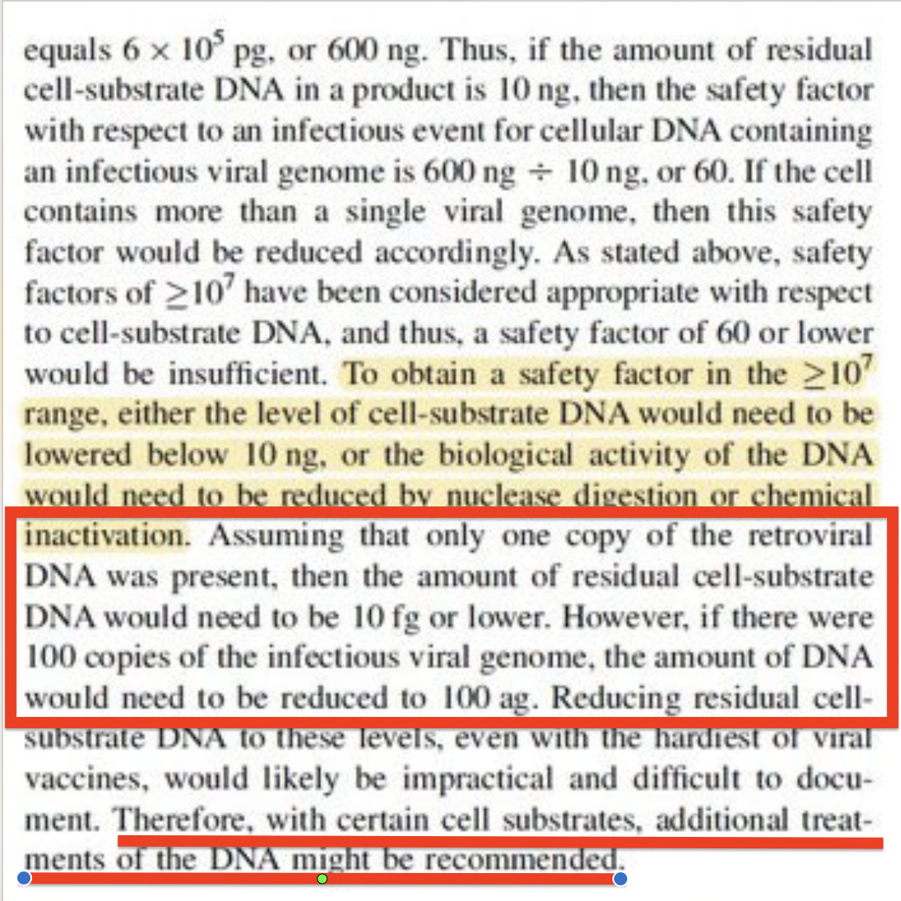
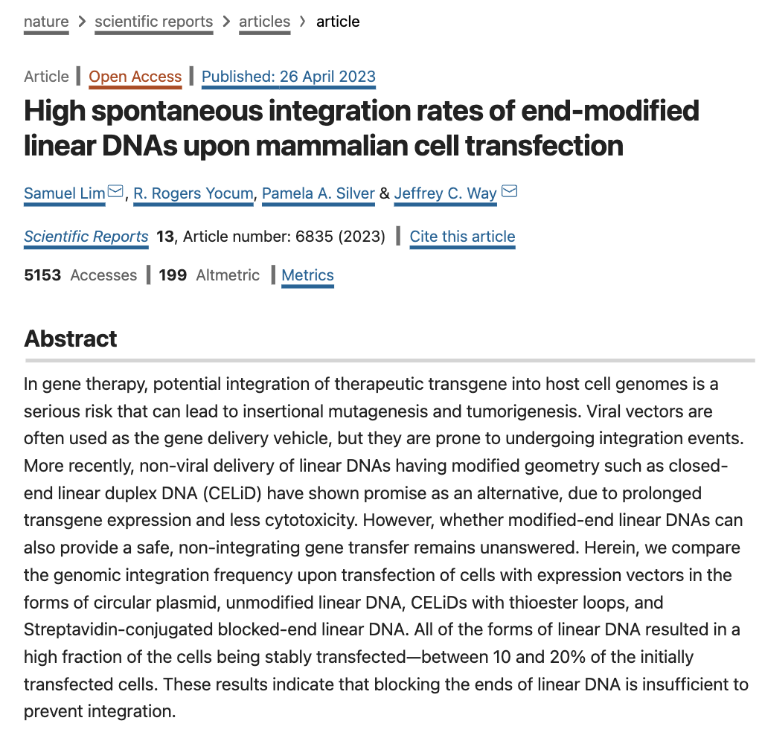
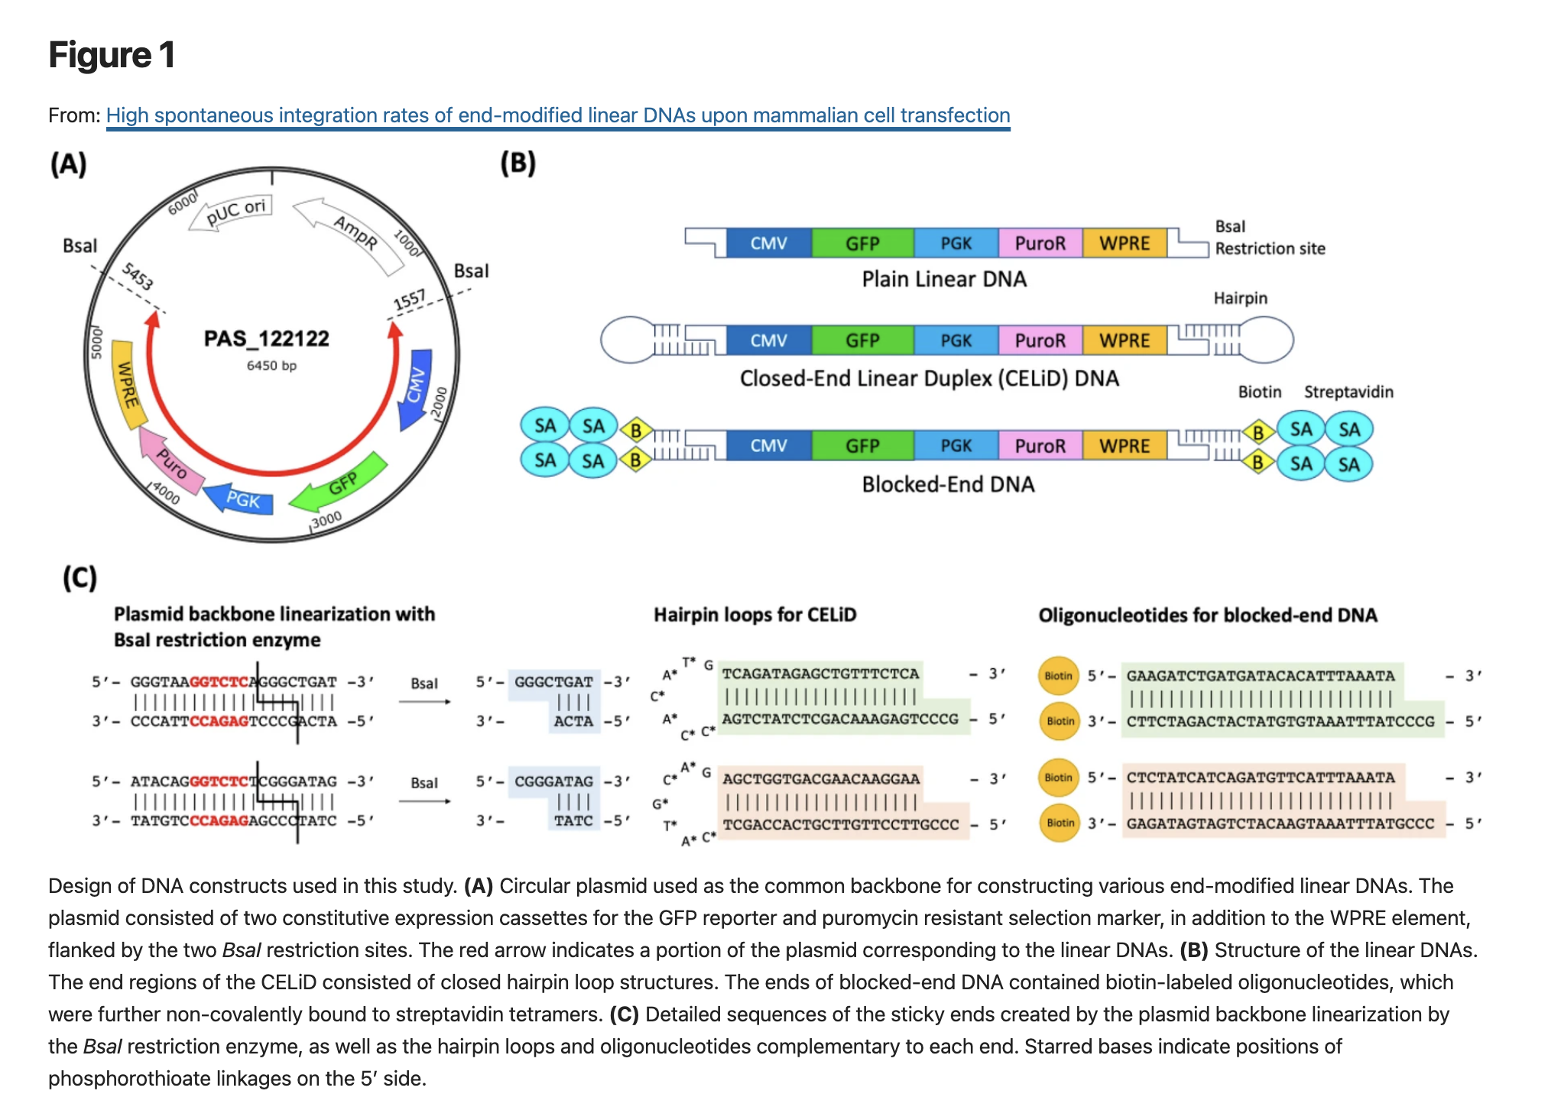
FDA guidelines were derived from Cell Substrate gDNA
10ng of gDNA = 1,000 copies of the human genome
10ng of 200bp DNA = ~50 Billion copies
Many more active DNA ends
(3’Hydroxyls and 5’ Phosphates)

Slide 20
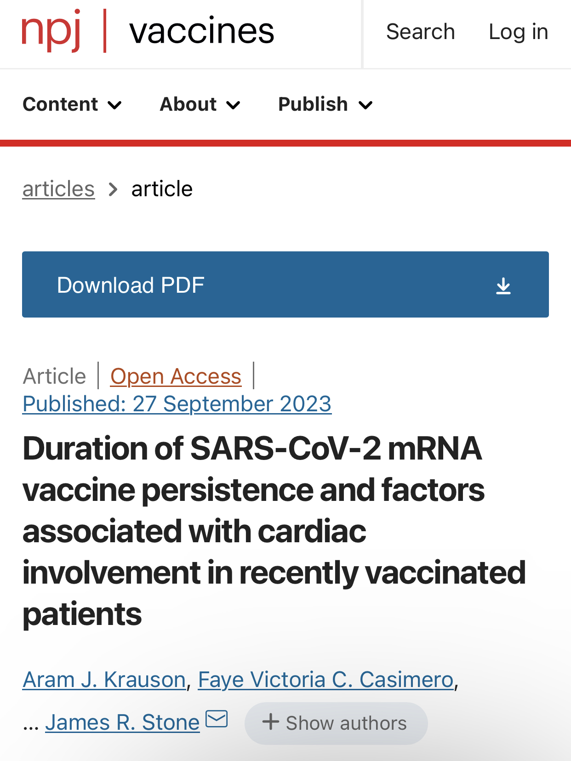
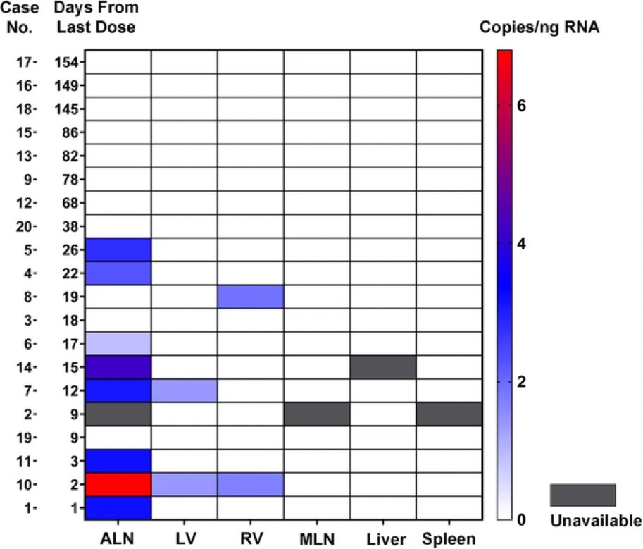
modRNA is found in Heart Tissue 30 days after vax

Slide 21
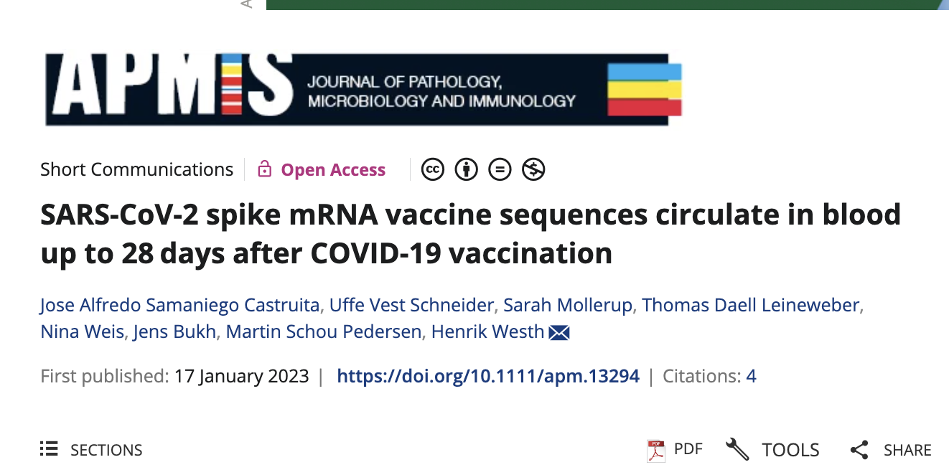
Spike nucleic acid persistance
Found in Placenta
Found in Plasma 28 days later

Slide 22
Cancer?
We are always Cancering. When the mutagenesis outpaces the immune system, you begin to notice it.
The 3 hit hypothesis
1)Increased mutagenesis with dsDNA contamination
2)Chronic insult to the Innate immune system from modRNA vax.
N1-methyl-pseudouridine, Lymphocytopenia, neutropenia, IgG4
3)Inhibition of p53 and BRCA1 (guardians of the genome)

Slide 23
Regulatory Response 1)Yes, SV40 is there 2)Yes, Pfizer did NOT spell this out 3)DNA is too small in length to matter 4)DNA is too small in quantity to matter 5)DNA is non-functional
Regulators are correct
Regulators are wrong

Slide 24
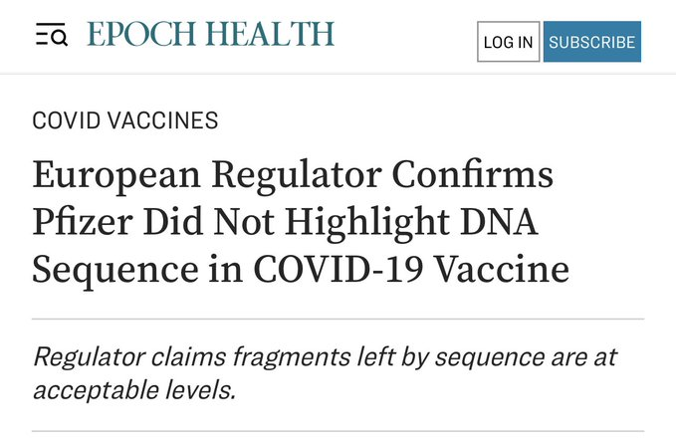
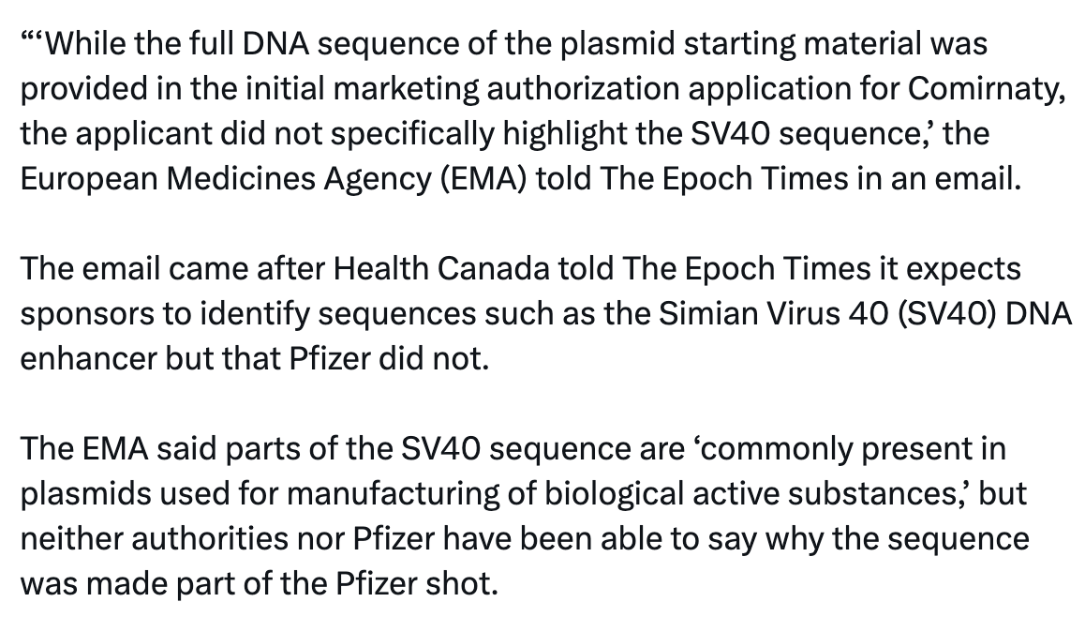
Pfizer did not specifically highlight the SV40 sequence
Annotation software by default highlights these sequences.
Someone had to intentionally delete them!!!

Slide 25
The Health Canada, FDA and the EMA: Intent to Deceive
FDA: “The omitted regions are not material to plasmid manufacturing”
You cannot manufacture plasmid DNA without the Promoter for Selection genes

Slide 26
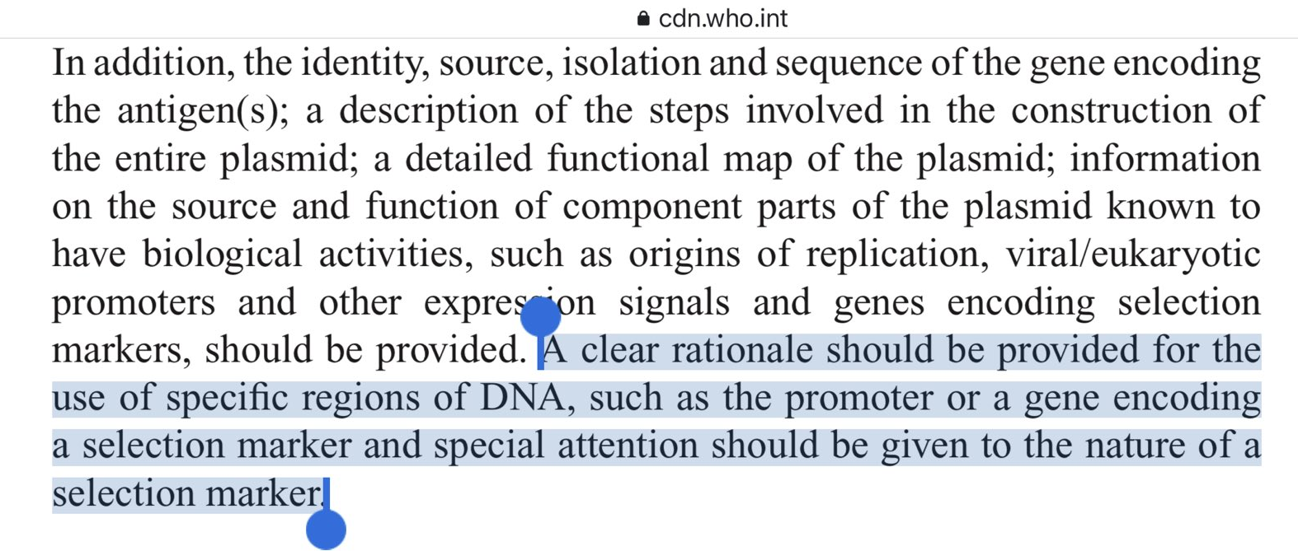
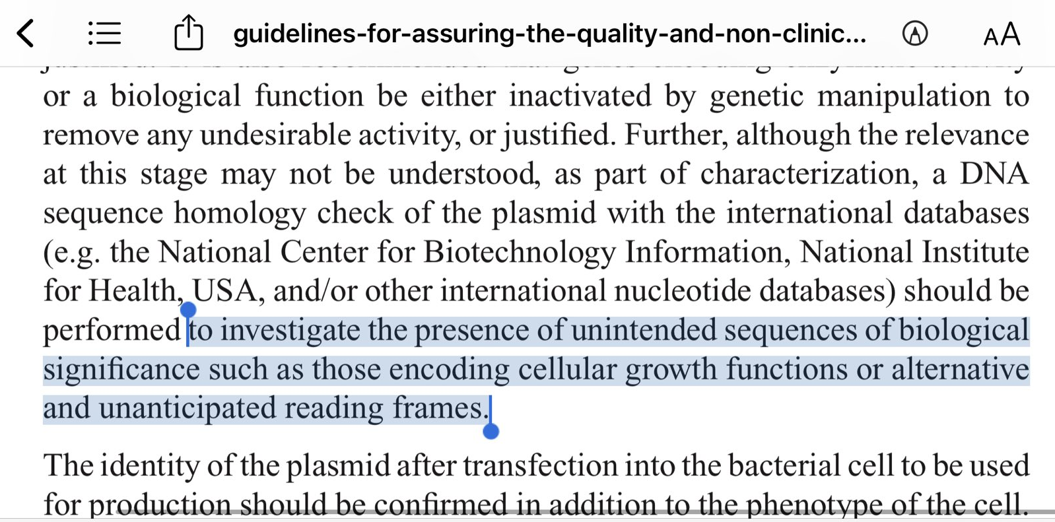
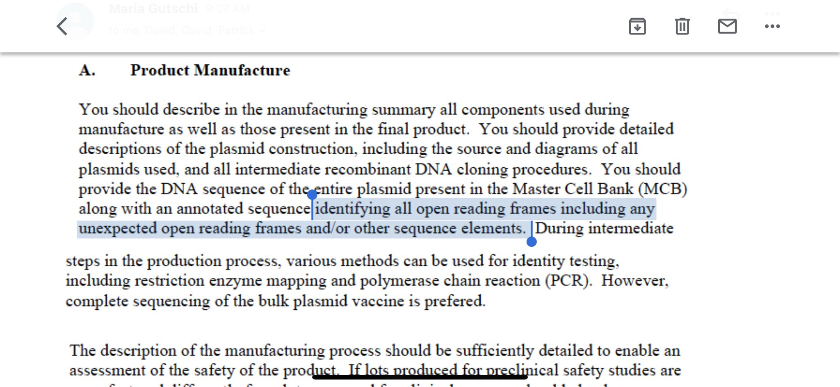
Both the FDA and WHO guidelines demand all Open Reading Frames and promoters like the SV40 elements must be disclosed to regulators.
The regulators are rewriting their own guidelines on the fly to accommodate for this

Slide 27
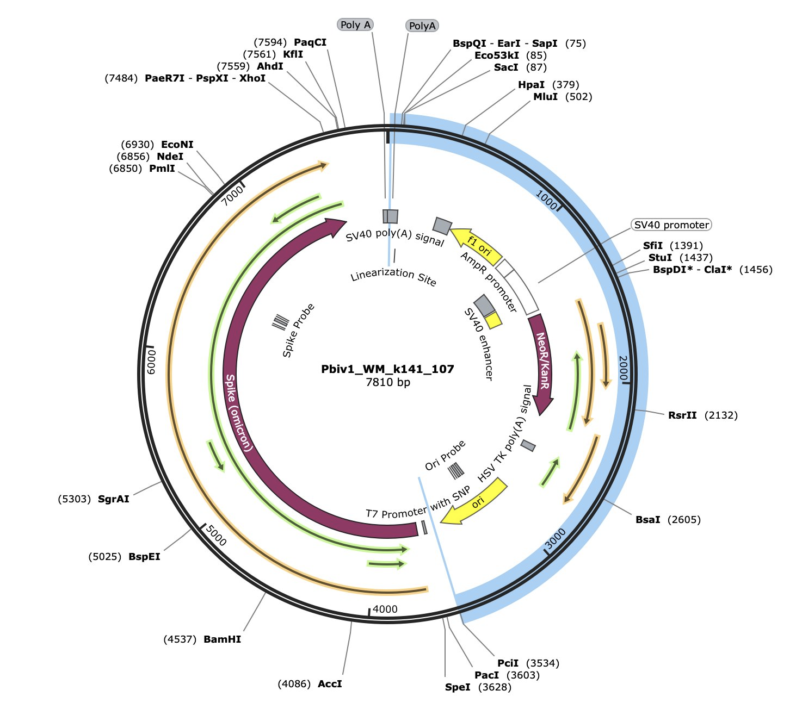
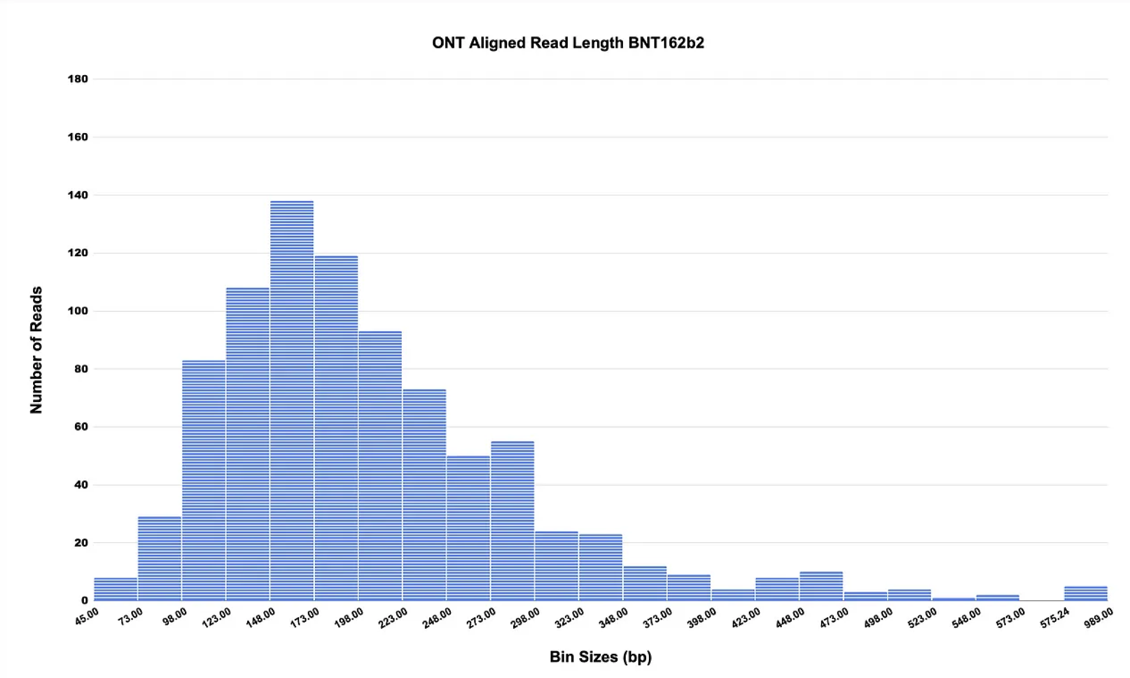
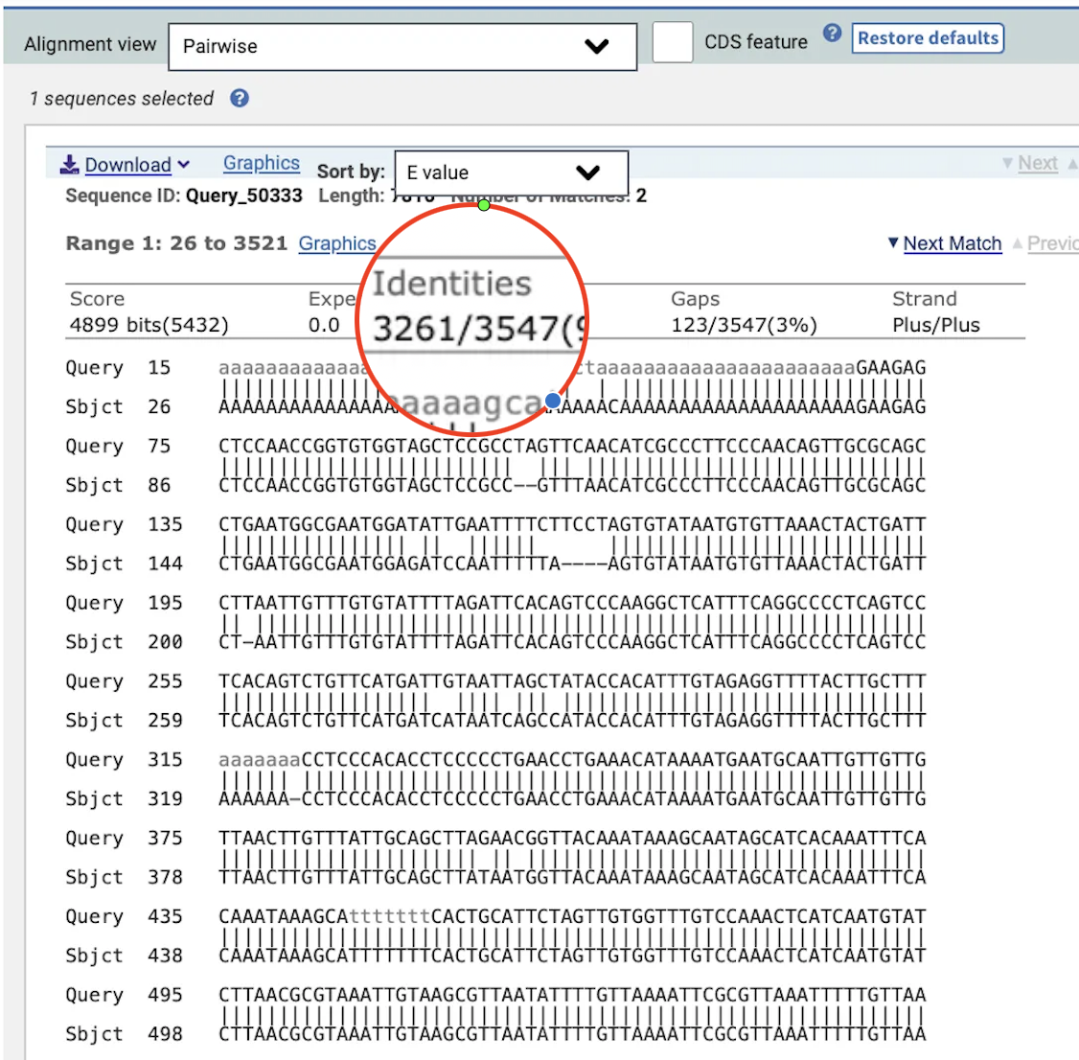
Too Little-Too small: qPCR under estimates the total DNA contamination
Ampure Bias
2.6 and 3.2 Kb reads detected. Mean = 214bp
Oxford Nanopore Sequencing

Slide 28
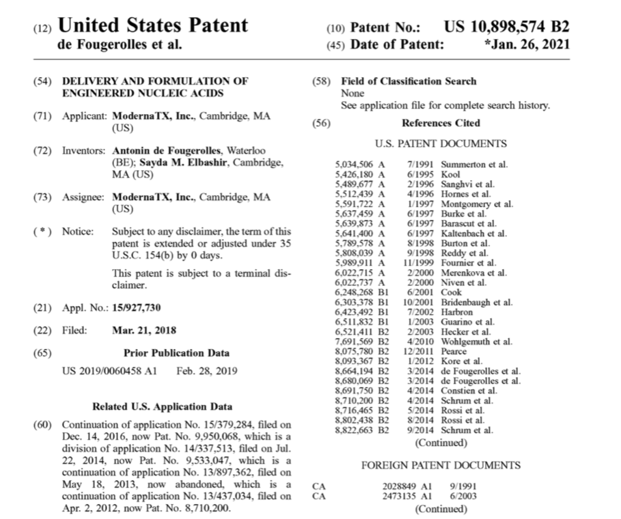
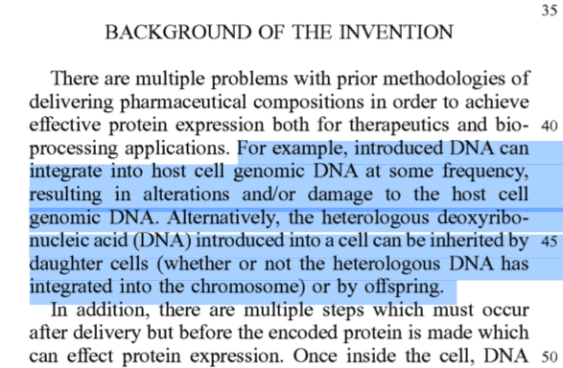
Moderna Patent speaks to the risk of insertional mutagenesis from DNA contamination

Slide 29
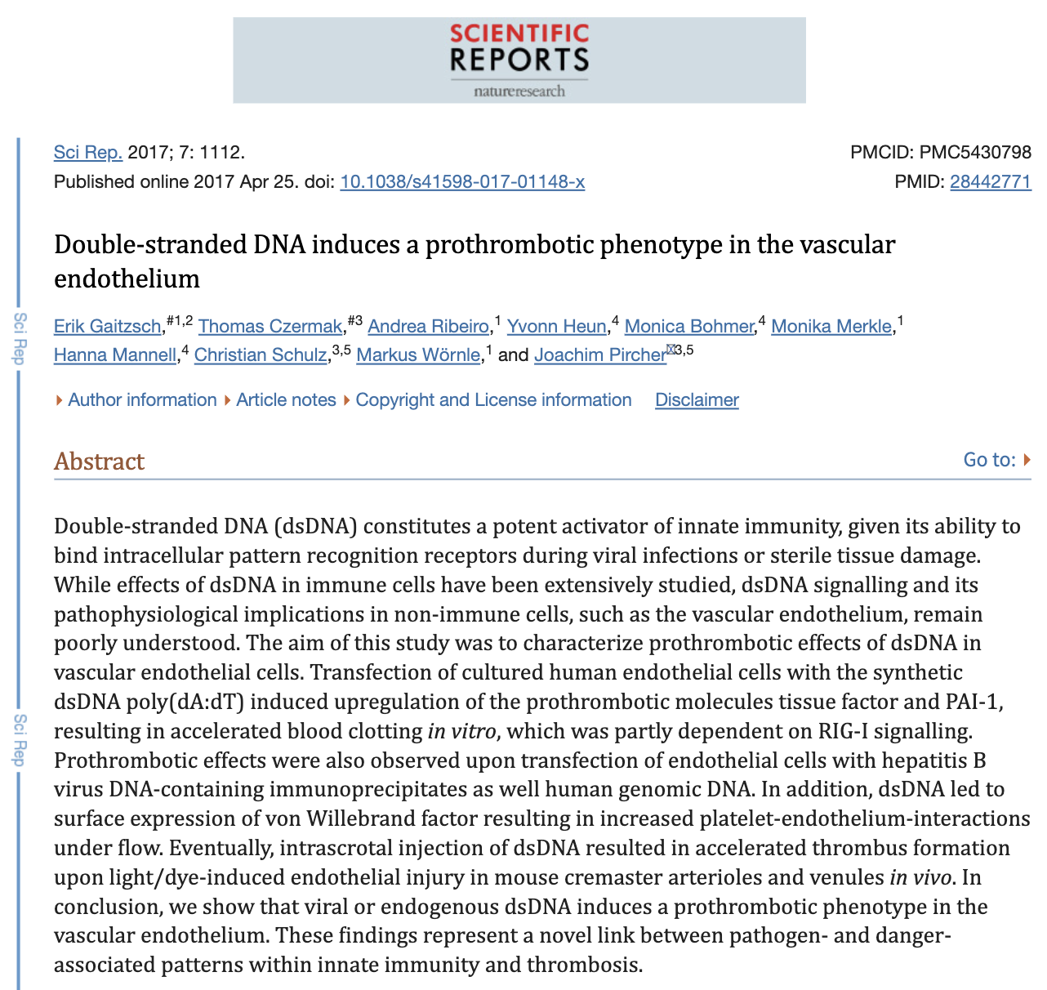
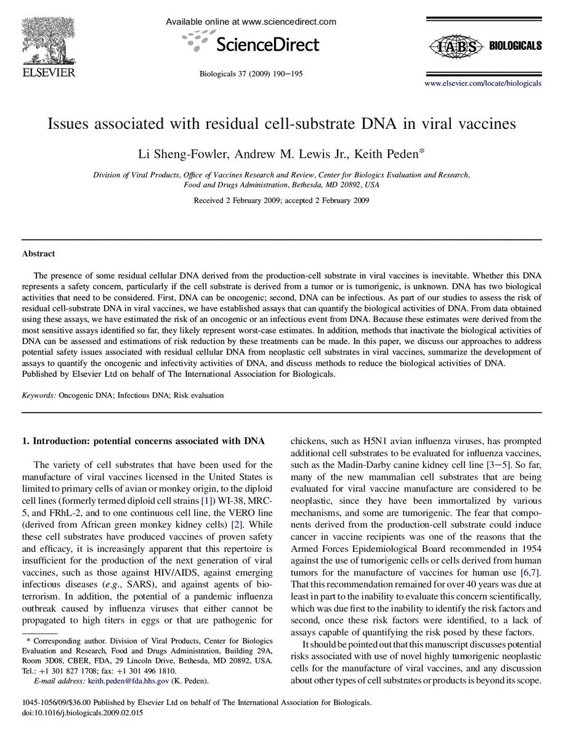
DNA is non Functional
Prothrombotic
DNA integration risk- Keith Peden/FDA

Slide 30
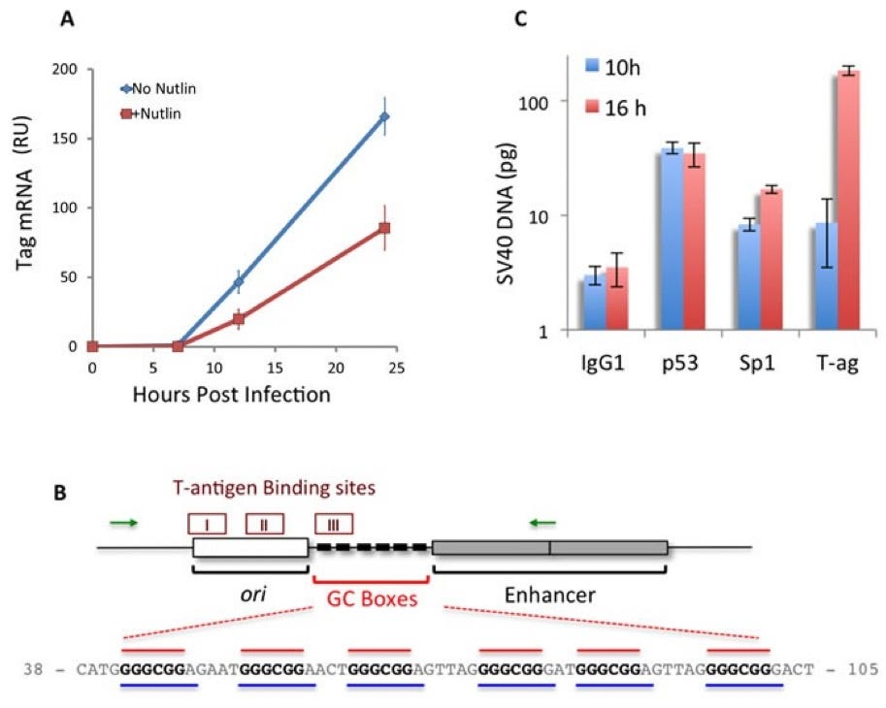
SV40 Promoter Binds to p53 Tumor Suppressor gene

Slide 31
Preliminary evidence of integration in Cancer cell lines

Slide 32
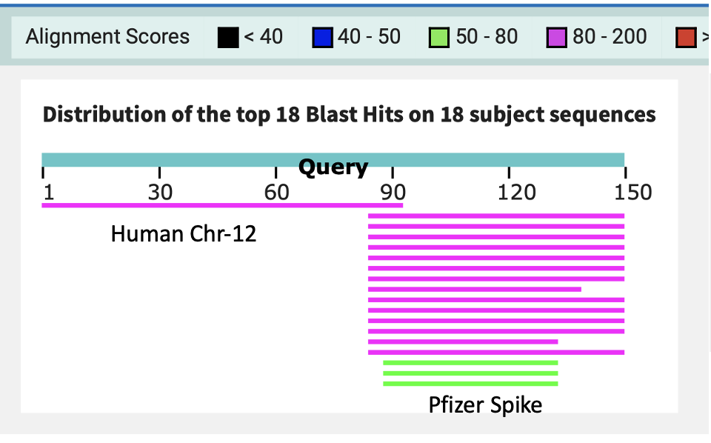
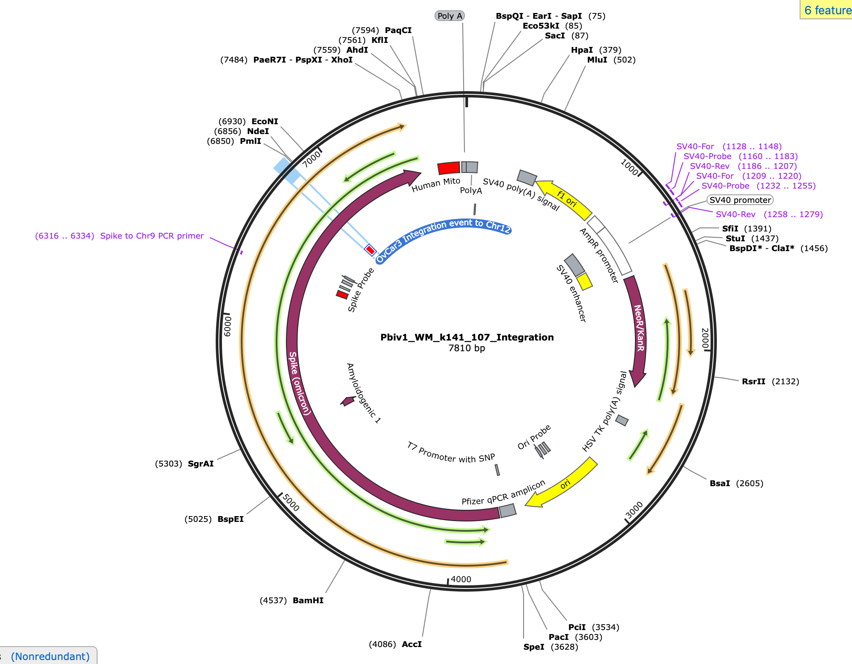
BNT162b2 Spike Integration Chr.12

Slide 33
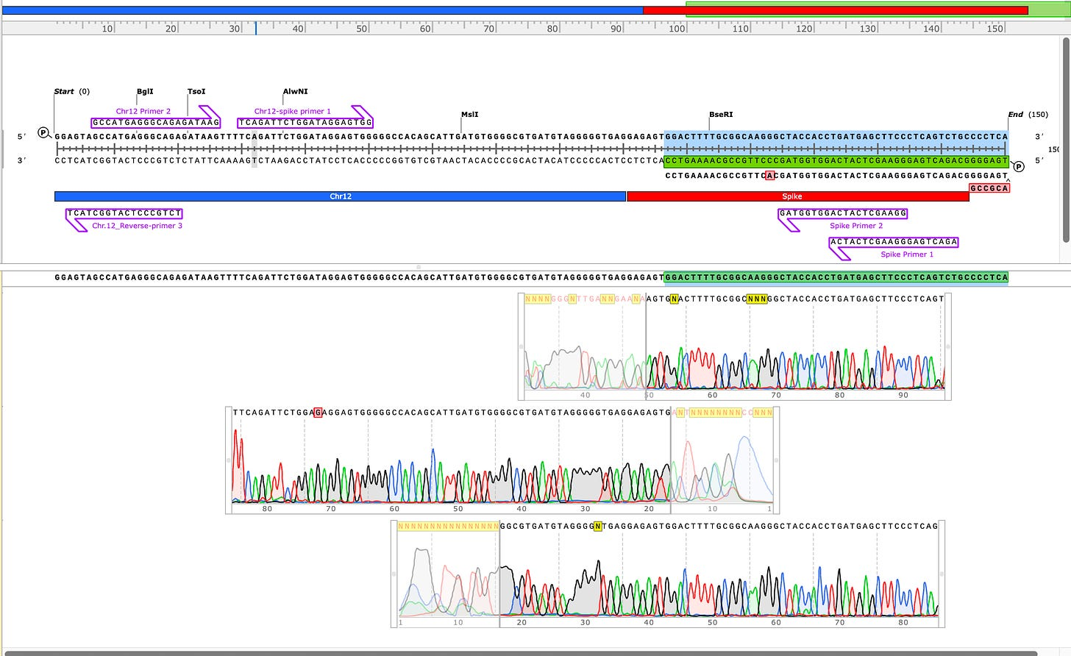
Sanger validation of Integration on Chr12 and Chr9

Slide 34
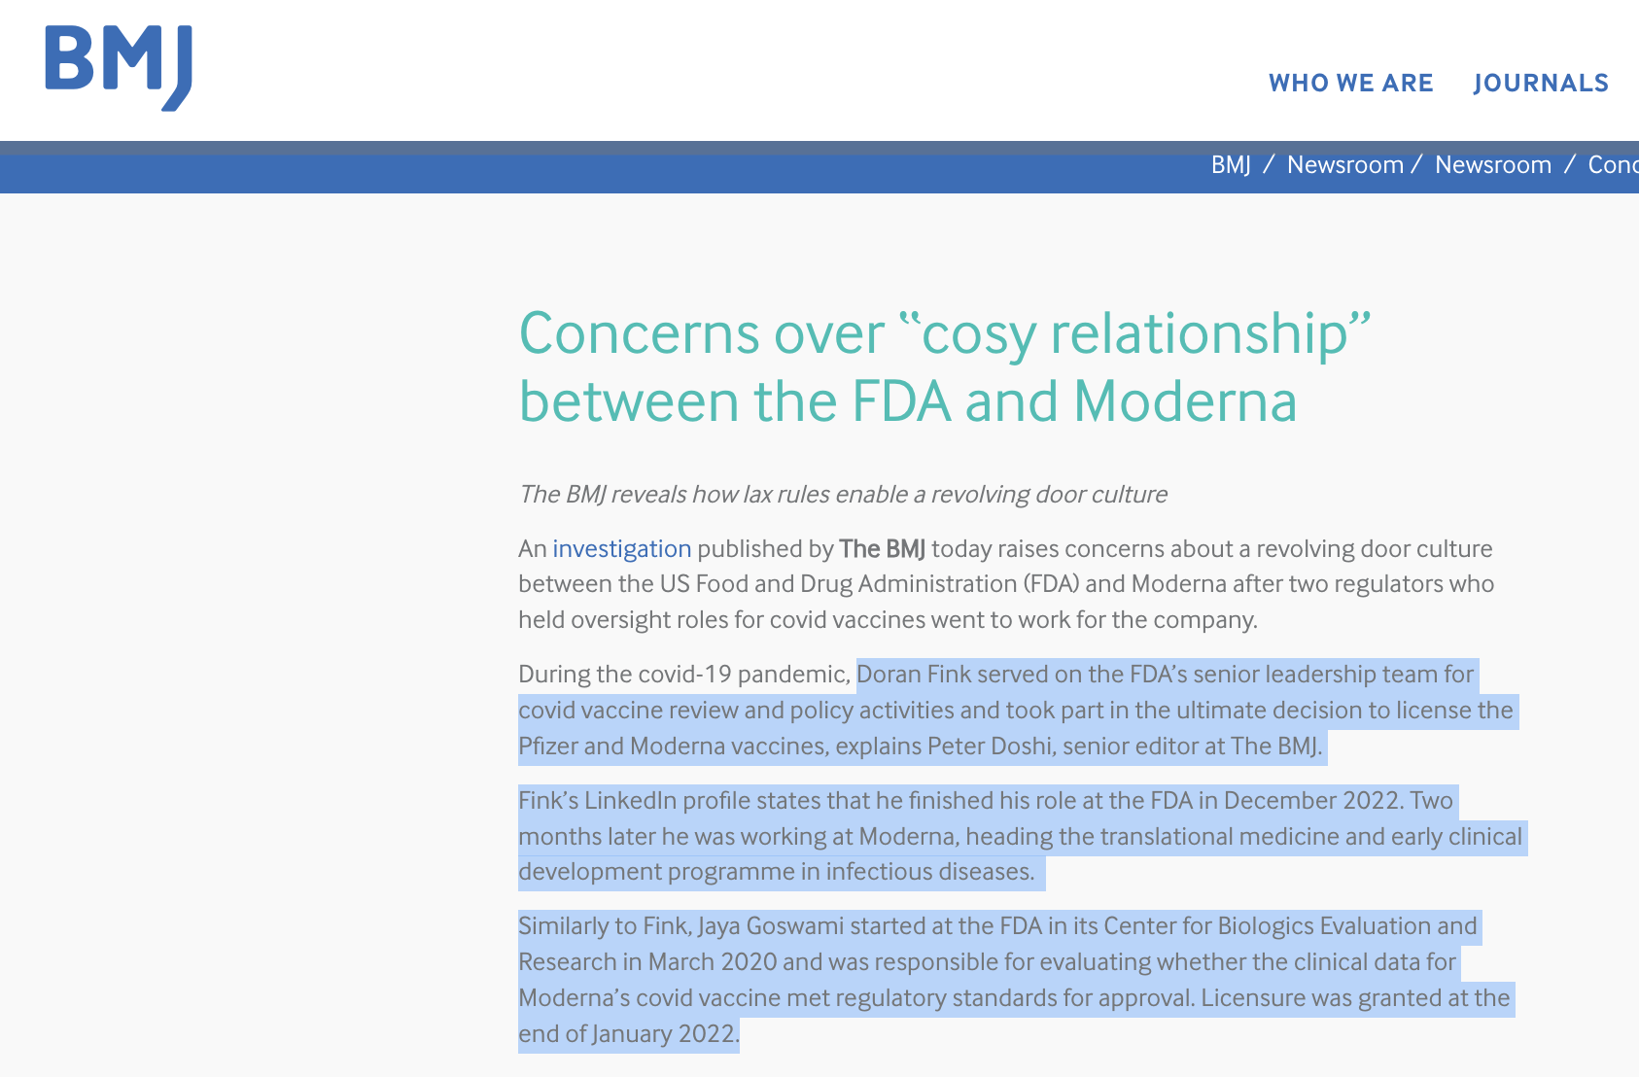
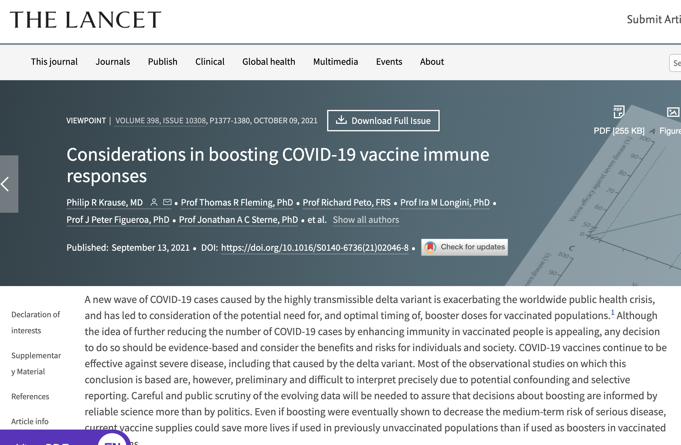
Revolving Door Culture at the FDA
Resigned in Protest
Hired by Moderna
Does Massachusetts have the same conflicts with the large Pfizer and Moderna tax base?

Slide 35
qPCR for tissues of concern
Blood Banks
Sperm Banks/Fertility clinics
Breast Milk
Transplant organs
Biopsies
qPCR tests are now kitted and can screen patients tissues to prioritize sequencing.
Its time to start sequencing vaccine injured patients.
We need CLIA labs to help with this.
We have the qPCR reagents to get this moving

Slide 36
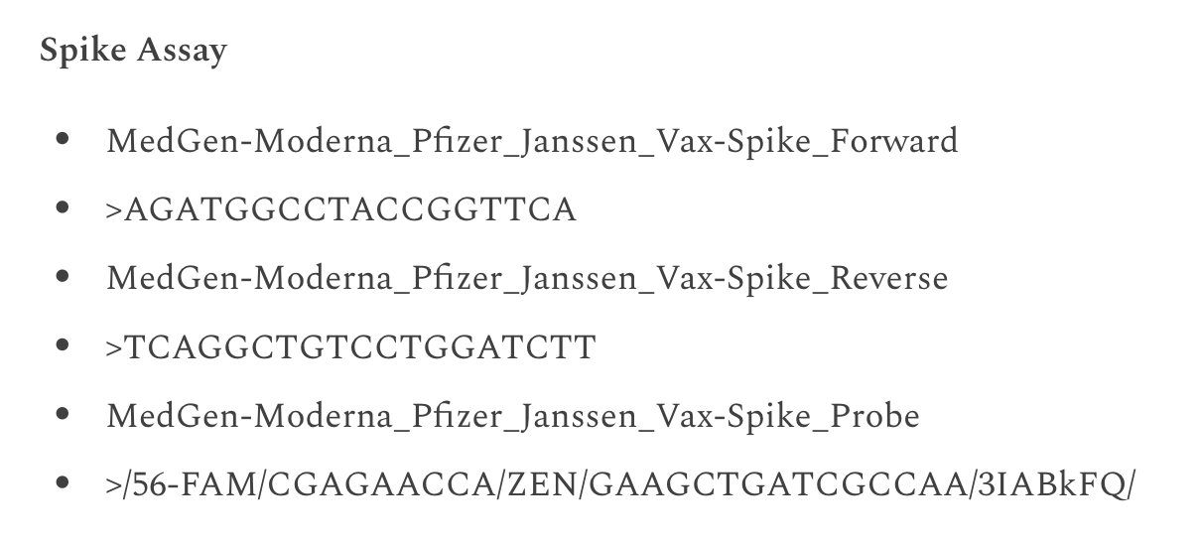
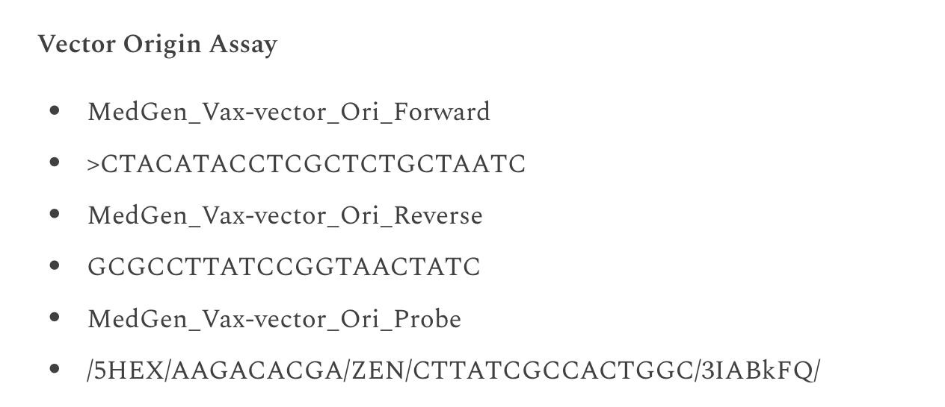
Call to Action: Manufacture Kits
In 60 minutes, dsDNA contamination can be measured with direct qPCR of the vaccine vials for less than $100/vial
Using 1/300th of a dose.

Slide 37
Thank you for your time and consideration Please end this deception Kevin.McKernan@medicinalgenomics.com https://anandamide.substack.com/

